Slide 1
















INTRODUCING PHOTOVOICE
WHAT IS PHOTOVOICE?
[YOUR ORGANISATION]
COMMUNICATE YOUR FEELINGS
PHOTOVOICE
RESEARCH
Photovoice is a research method that was created by Professor Caroline Wang and her colleagues in the 1980s. It enables people to identify issues, represent their communities and
OUR PROJECT
CREATED IN [ADD THE DATE]
WHY PHOTOVOICE?
INSPIRE AND RELATE TO PEOPLE
[Write a few words here about what your project is looking at and hoping to achieve.]
Photovoice entrusts people to document, discuss and create change through the power of photography. Photos can be a powerful way of communicating without words.
Your phone number
Your email address
Your website
OUR AIM
Your postal address
SHARE OUR EXPERIENCES
We are researching [add your topic here]. We are hoping to [add what you want to achieve/ educate people on through your photos].
WWW.REALLYGREATSITE.COM

Slide 2





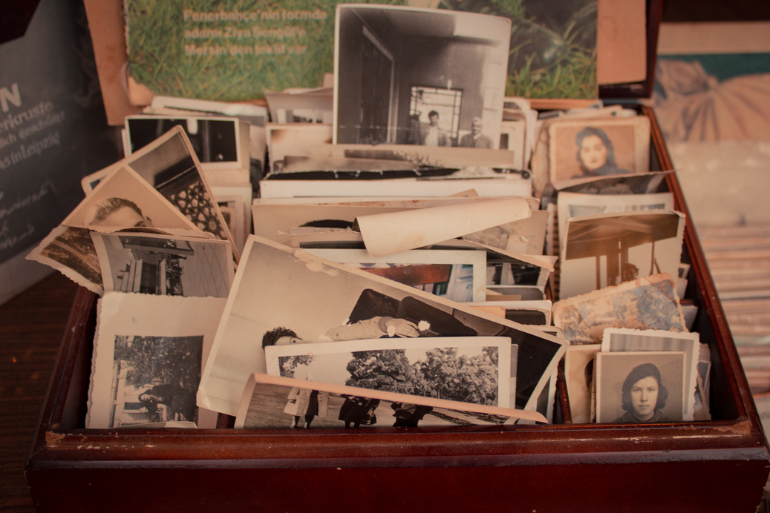



OUR
THE PROJECT STAGES
PHOTOGRAPHY
IN FIVE EASY STEPS
EXHIBITION
1
THE TOPIC
SELECT A TOPIC TO FOCUS ON
WHAT
2
PHOTOGRAPHY
We will be showcasing our photos in a photography exhibition so that the general public can see our work.
TAKE THE PHOTOS BASED ON THAT TOPIC
3
DISCUSSION
WHERE
TALK ABOUT THE PHOTOS
123 ANYWHERE ST., ANY CITY
4
SHARE
WHEN
SHARE THE PHOTOS IN AN EXHIBITION
DATE, MONTH, YEAR
BETWEEN 2-7PM
5
EVALUATE
COME ALONG AND SEE OUR PROJECT RESULTS
GET FEEDBACK FROM THE GROUP AND THE PUBLIC
WWW.NAMEOFYOURWEBSITE.COM

