Slide 1


Consent form for taking part
Thank you for taking an interest in this research.
You have had a chance to see the Information Leaflet and ask any questions.
This consent form shows that you agree to join in each part of the research. You will have a copy of this form to take away so you can check it again in future.
Please tick the boxes in this form
if you agree.
No tick means that you do not agree
to that part of the study.
If you do not agree to most parts of the study, it might mean that taking part is not right for you.

Slide 2




 | I have read the information leaflet or I have had it read to me. I have had a chance to think about it. I understand what this research is about.
 | I have asked all the questions I want. Someone has answered my questions in a way that I understand.
 | I understand that I can say no to this research at any time.
 | I understand that my personal information will only be shared with the team transcribing the audio and video recordings. I understand they will look after my information carefully.

Slide 3




 | I understand that if the researchers find out that someone is harming me or someone else, they cannot keep this private.
 | I agree for some of the things I say to be used in this research. I know my name will not be used. But I can choose to use my real name in the exhibition.
 | I understand the good things and bad things about taking part.
 | I understand the research team will follow UK law about keeping my private information safe.

Slide 4
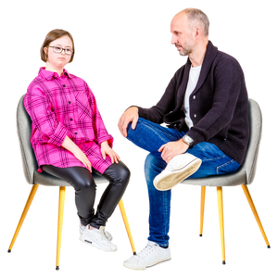

 | I know who to talk to if I want help or more information. I know who to talk to if I want to make a complaint.
 | I am happy to take part.
If you have not ticked any of the questions or you do not want to take part,
you do not have to sign.
If you want to take part you can sign below
Name
Signature
Date
The person who explained this research to you will also sign to say they are sure you understand.
Name
Signature
Date

